Slide 1
App inventor(Android) , PyQt5
모바일-웹 Client 제어
매직에코 이성문
magiceco@magice.co

Slide 2
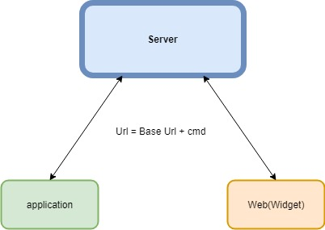
목차
※We don’t offer any programming skills and basic or specific directions.
What is Mobile
App Inventor
App - 실습
Web – for ui
Qt designer - 실습
(Client <-> Server 관계)

Slide 3
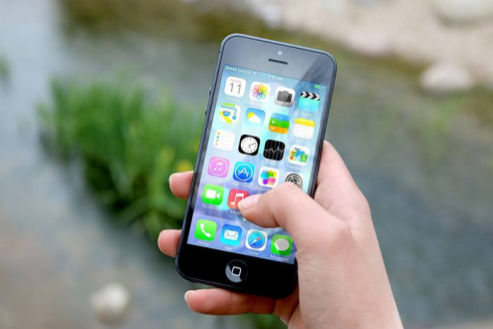
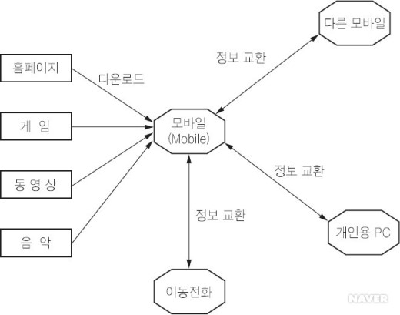
Mobile
What is mobile?
Mobile은 원래 ‘움직일 수 있는’ 이라는 뜻.
현대 Mobile : 스마트폰(smartphone) 과 태블릿(tablet) PC 등과 같이 이동 중 사용이 가능한 컴퓨터 환경

Slide 4
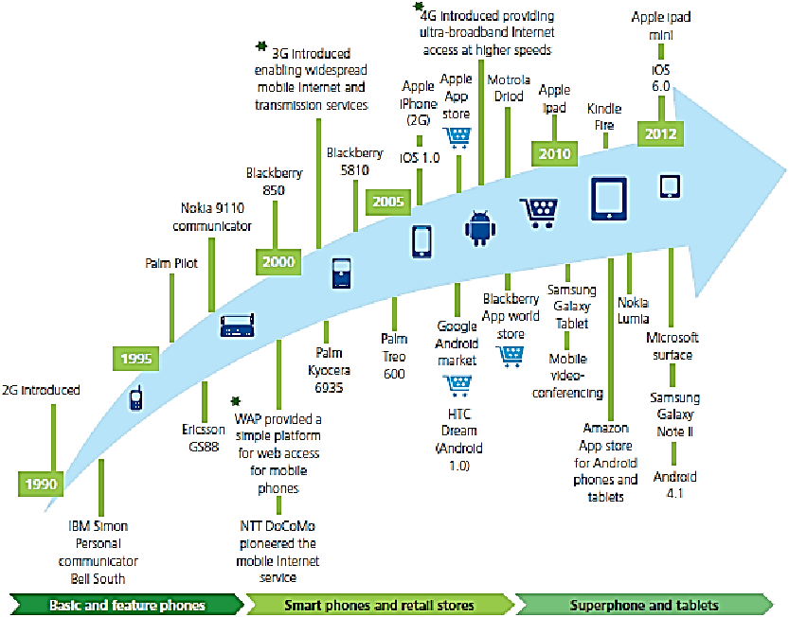
Mobile
History of Mobile

Slide 5
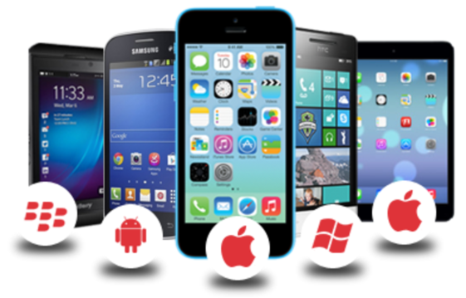
Principles of Mobile Computing
The following factors have been identified as the Principles of Mobile Computing.
Portability
Devices/nodes connected within the mobile computing system should facilitate mobility.
Connectivity
This defines the Quality of Service (QoS) of the network connectivity.
Interactivity
The nodes belonging to a mobile computing system are connected with one another to communicate and collaborate through active transactions of data.
Individuality
A mobile computing system should be able to adopt the technology to cater the individual needs and also to obtain contextual information of each node.

Slide 6
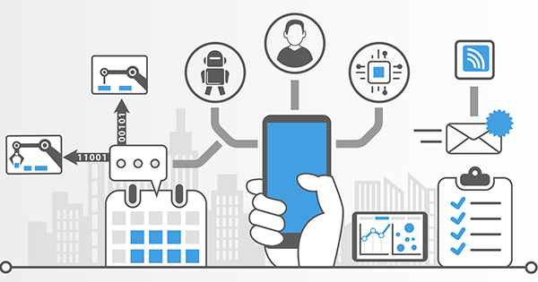
4차 산업혁명 속 Mobile
시간과 공간을 뛰어 넘는 공감과 소통
개인이 사회에 미치는 영향 증가
온라인, 오프라인 세계를 연결하는 주요 매개체
자율 주행, Wearable, Iot 등 차세대 기술의 필수 요소
Now we will make an client application for our magic car.

Slide 7
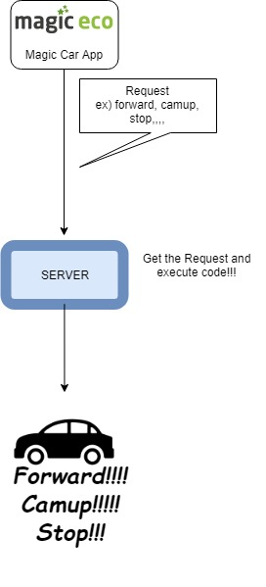
Magic car Application
The OS of applications
Android
iOS
But iOS is available only on Mac.
So, we will make Android version app.
The Android Studio is made for building
Android applications but it’s not easy.
So, we will make that app by using
App Inventor!. This is easy.

Slide 8

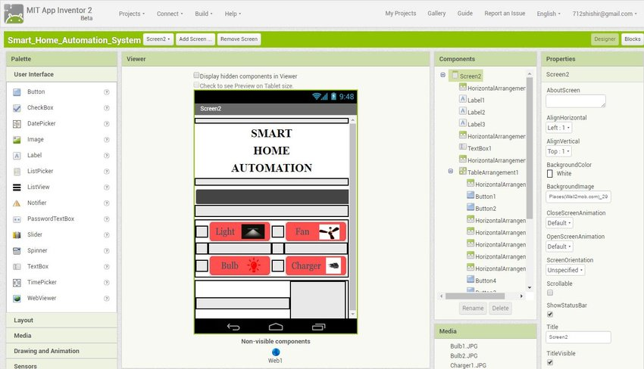
App Inventor
What is App Inventor?
MIT App Inventor is an intuitive, visual programming environment that allows everyone – even children – to build fully functional apps for smartphones and tablets.

Slide 9
App Inventor
How to use?
ai2.appinventor.mit.edu/ 로 접속 후 create apps 클릭.
자신의 Google 아이디로 접속.
Start a new project.
Design your first application !!
※ 주의 : 처음 생성하는 screen 1 이 어플 실행시 제일 먼저 보여지는 screen임.

Slide 10
App Inventor
How to emulate?
Using Emulator.
Virtual machine of App inventor
Using Your SmartPhone (Android)
Real Device

Slide 11
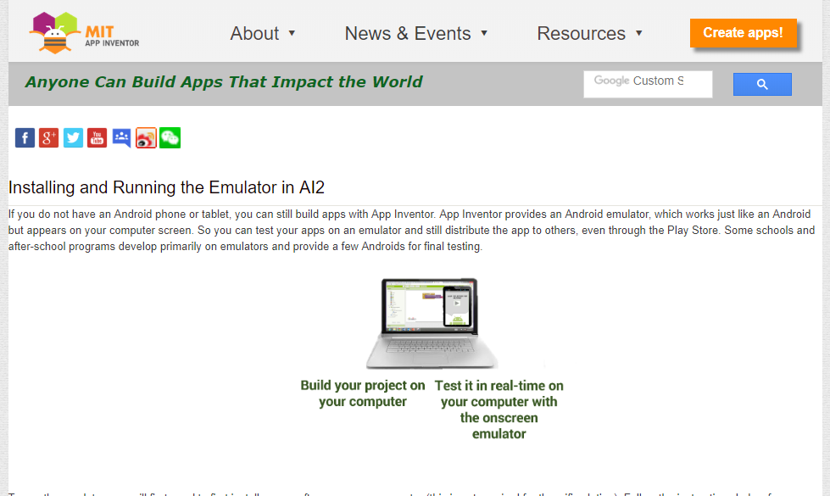
App Inventor
How to emulate with Emulator
1. Install Aistarter in the site.
http://appinventor.mit.edu/explore/ai2/setup-emulator.html

Slide 12
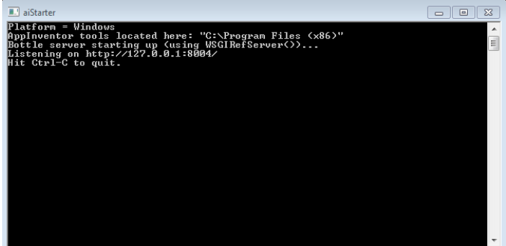
App Inventor
How to emulate with Emulator
2. Start AiStarter and keep it in your window.

Slide 13
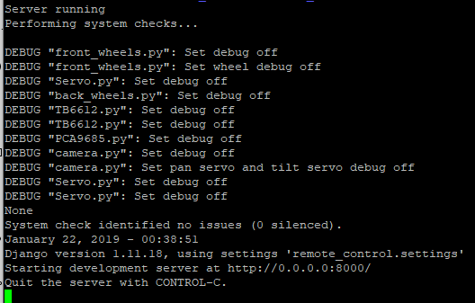
App Inventor
How to emulate with Emulator
3. Raspberry pi 서버 접속 (./start )

Slide 14
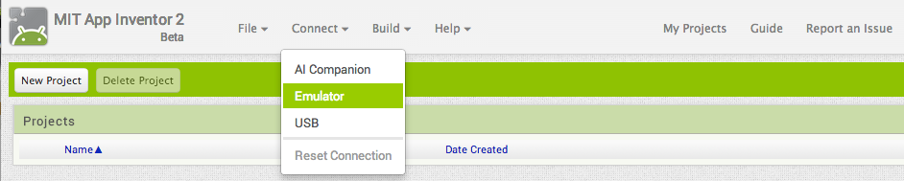
App Inventor
How to emulate with Emulator
4. Open an App Inventor project and connect it to the emulator

Slide 15
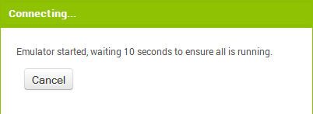
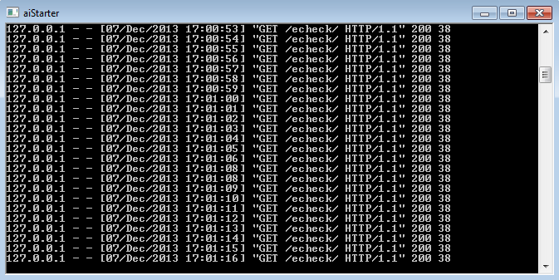
App Inventor
How to emulate with Emulator

Slide 16
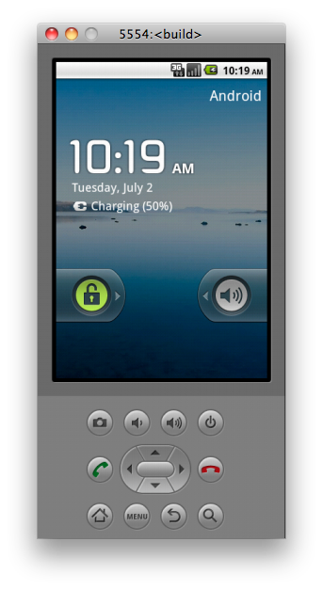
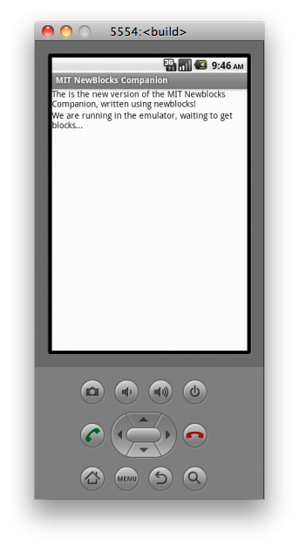
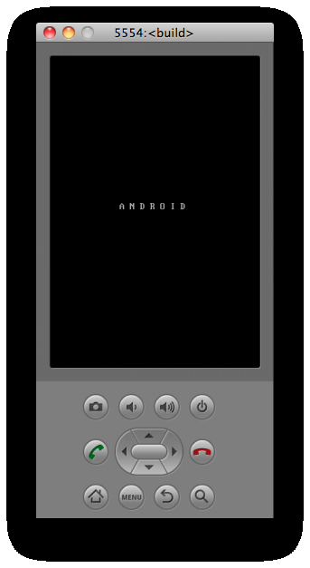
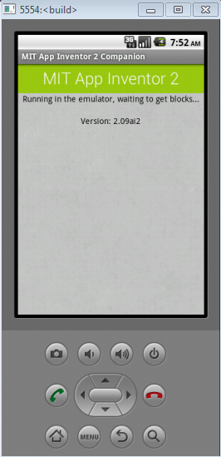
App Inventor
How to emulate with Emulator
5. After waiting for a while, you can see your app activating.

Slide 17
App Inventor
How to emulate with USB ( Android Smartphone )
1. Install and start Aistarter (same with using emulator )

Slide 18
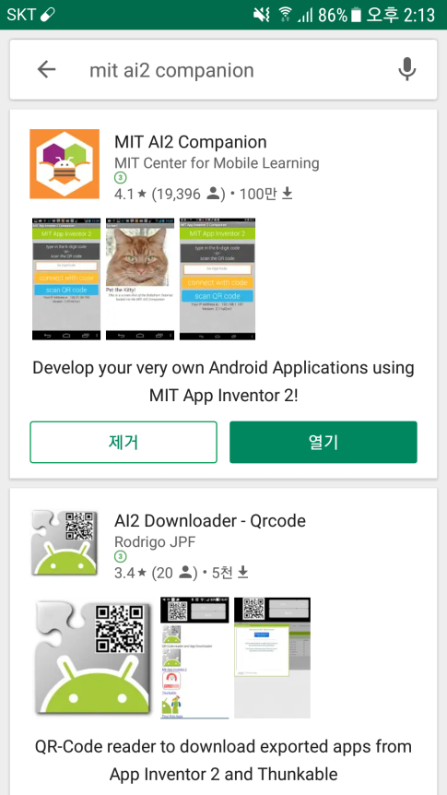
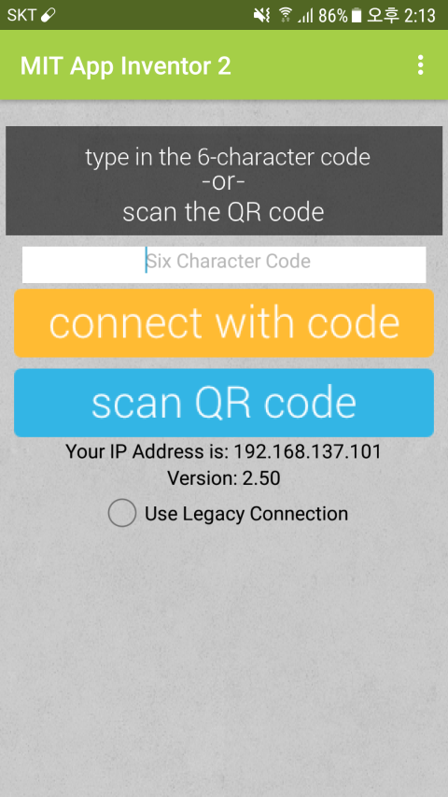
App Inventor
How to emulate with USB ( Android Smartphone )
2. Connect your device with your computer and install MIT AI2 Companion application in your device and start the app.

Slide 19
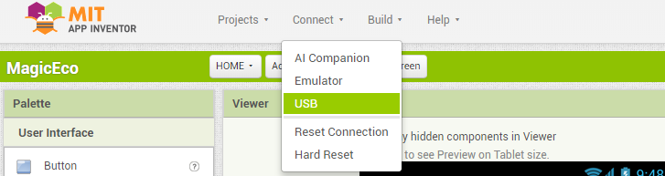
App Inventor
How to emulate with USB ( Android Smartphone )
3. Open an App Inventor project and connect it to the emulator

Slide 20
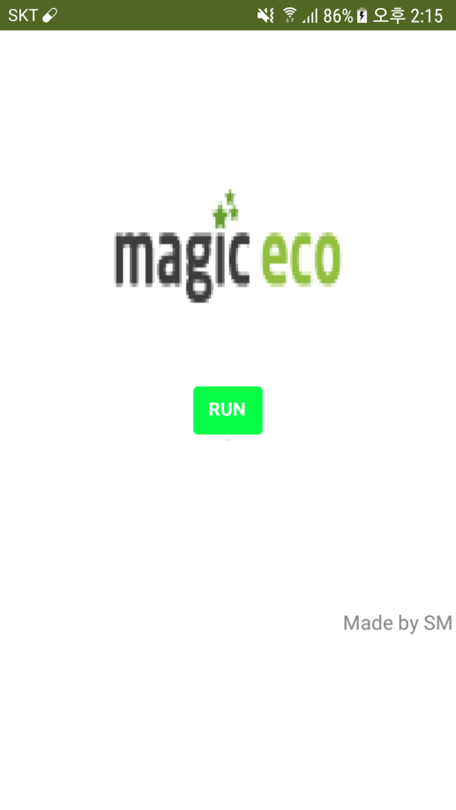
App Inventor
How to emulate with USB ( Android Smartphone )
4. After some waiting, you can see your device starting your first application.

Slide 21
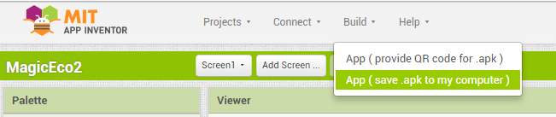
App Inventor
How to install your application in your device
1. Go to “build” and save your application in your computer by apk file.

Slide 22
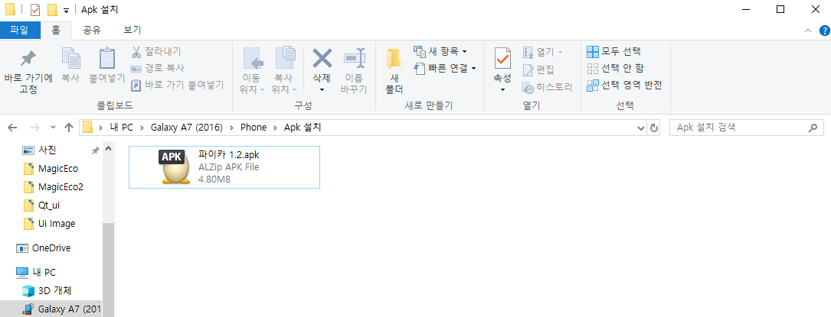
App Inventor
How to install your application in your device
2. Connect your device (Android) with the computer and move your .apk file to your device. (in any directory.)

Slide 23
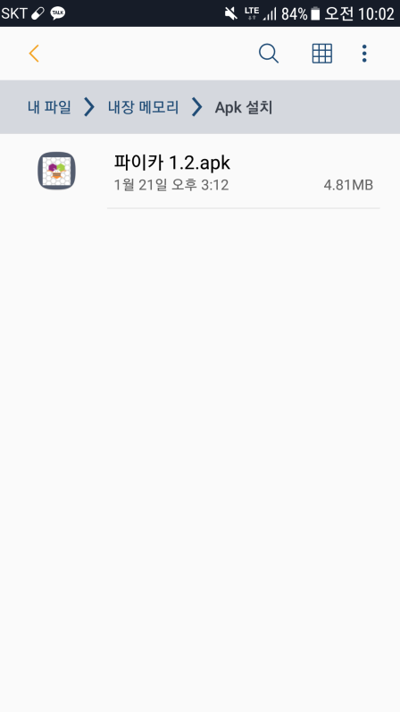
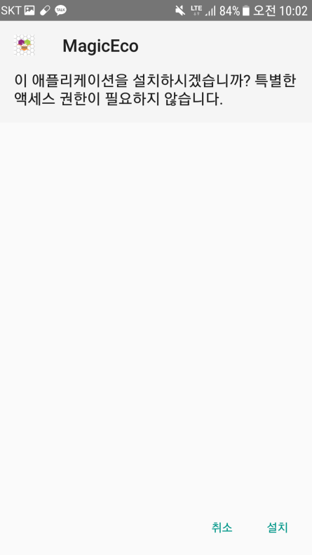
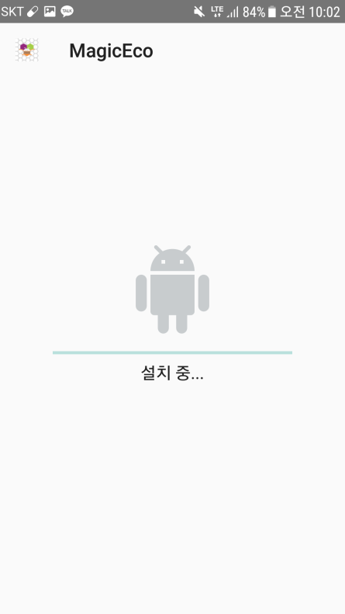
App Inventor
How to install your application in your device
3. Following designated path in your device, click your .apk file and install it in your smartphone.

Slide 24
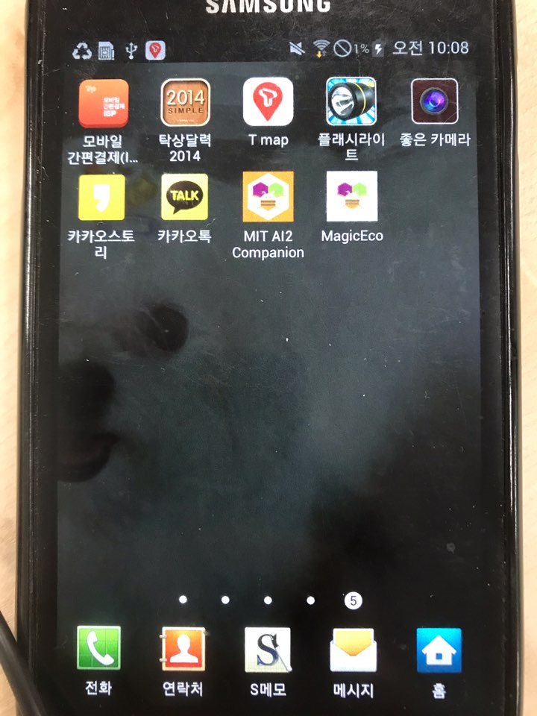
App Inventor
How to install your application in your device
4. Then you can see your first application in your device and you can execute it without connecting with computer.

Slide 25
App Inventor
부록
Make sure that your device and your server are in same network!!
The IP you will input will be host in your app.
If aistarter doesn’t work properly, execute it by 관리자 권한

Slide 26

Web(PyQt5)
What is PyQt?
PyQt is a Python binding of the cross-platform GUI toolkit Qt, implemented as a Python plug-in.
We will make some ui(user-interface) for web client by
using qt designer.

Slide 27


Web(PyQt5)
Make ui by qt designer
1. Make sure that python is installed in your OS.
2. Open 명령 프롬프트 (cmd ) and type this.
pip3 install pyqt5
pip3 install pyqt5-tools
3. Then qt designer will be installed in this path.
C:\Users\{사용자} \ AppData\ Local \ Programs \ Python \ Python36-32\Lib\site-packages\pyqt5-tools\designer.exe
4. Execute designer.exe.

Slide 28
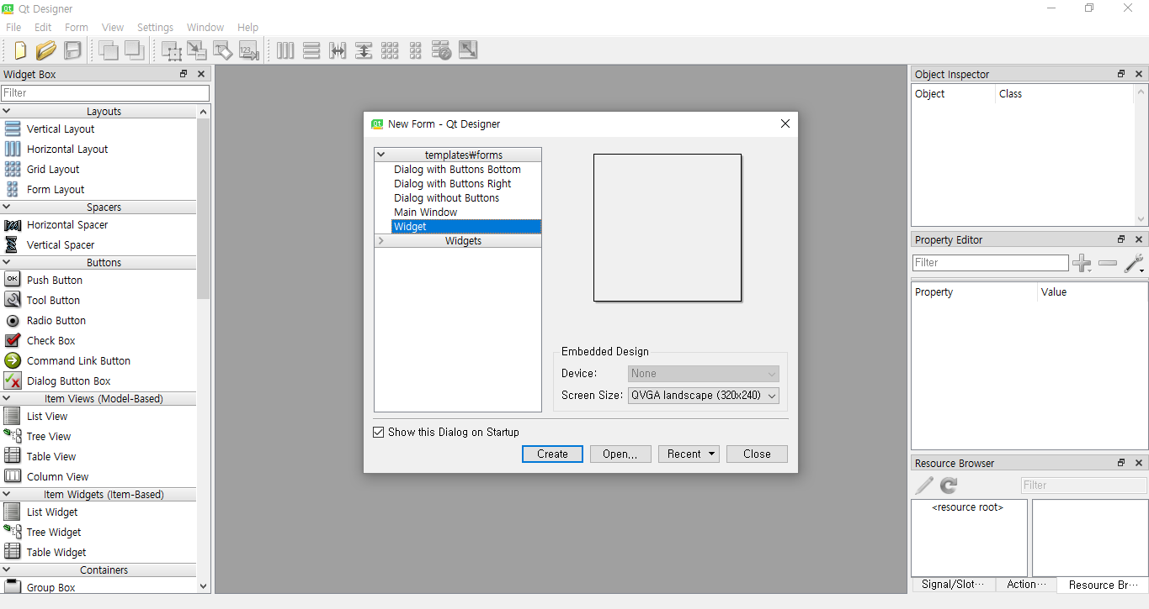
Web(PyQt5)
Make ui by qt designer
5. Design your own User Interface !!

Slide 29
Web(PyQt5)
부록
Remember the objects’ name because they are needed when you program a client file.
If you created .qrc file and when you execute your client, you need to convert the .qrc file into .py file by this command and import this .py file in your client code.
Ex) pyrcc5 resource.qrc -o resource_rc.py

